Slide 1
Incoming Grade Eleven Course Selection
Oromocto High School 2024

Slide 2
Agenda
Graduation Requirements
Required Courses: What you need to take.
How to choose your courses: Planning for your future.

Slide 3
NB High School Renewal
Students start earning credit hours in grade 10.
More opportunity to design a high school experience personalized to your strengths, interests, and post-secondary plans.

Slide 4
Class of 2026
Core Credit Clusters:
Languages & Literacies Mathematics Science Humanities Personal Wellbeing
Creative Arts
Wellness & Phys Ed
Career Connected
Choice
What you need to complete:
Learning Outcomes K-9
Compulsory Credit Courses 10-12
Minimum of 100 Credit Hours

Slide 5
Required Grade 10 Courses
ELA 10 Foundational
GMF 10
Civics
Second Language
Personalized Well-Being (PDCP 10)
Science Credit (choice)

Slide 6
Language Arts and Languages Required: 24 CH
Required:
ELA Foundational 112/113
Choose One:
ELA Extended 11
Writing 110
Intro to Wolastoquey 110
Intermediate Wolastoquey 110
Graphic Novels 120
Journalism 120
Children’s Literature 120
PIF 110
Spanish 110
Media Studies 120
American Sign Language 110
Canadian Literature 120

Slide 7
Mathematics Required: 12 CH
Pathway 1
Pathway 2-4
Finance and Workplace Mathematics 110
NBCC Skilled Trades Math 120
Foundations of Mathematics 110
Pre-Calculus 110
OR
Foundations of Mathematics 120

Slide 8
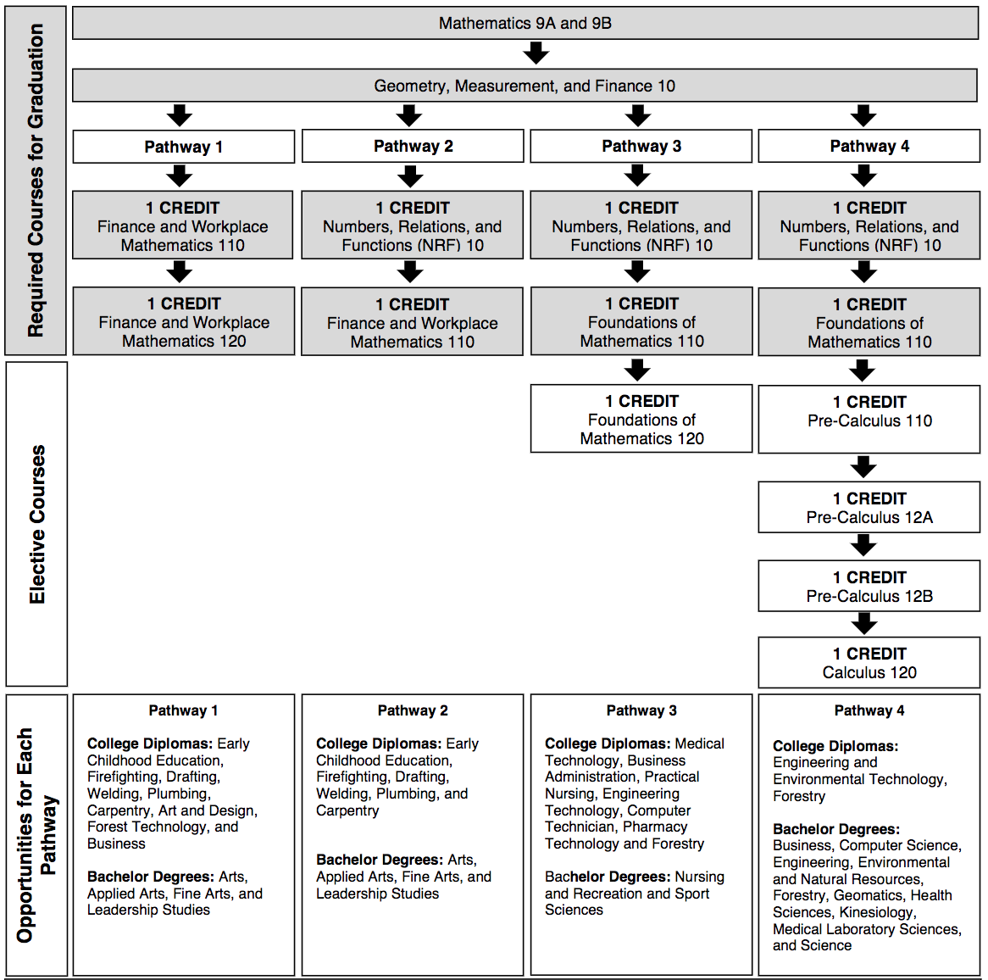
Math Pathways
1 CREDIT
NBCC Skilled Trades Math 120

Slide 9
Sciences Required: 8 CH
Physics 112 Chemistry 112 Biology 112 FI Biology 112 Agriculture 110 | Physics 122 Chemistry 122 Biology 122 Human Physiology 110 Environmental Geoscience 110 | Intro to Environmental Science 120 Intro to Electronics 110 Automotive Electrical Systems 120

Slide 10
Humanities Required: 8 CH
Ancient Medieval History 112
Modern History 112/113
FI Modern History 112
World Issues 120
Indigenous Studies 120

Slide 11
Personalized Well-Being Required: 20 CH
Creative Arts (4 CH) Wellness & Phys Ed (4 CH) Career Connected (4 CH) Personalized Well-Being Choice (8 CH)

Slide 12
Creative Arts
Creative Arts 110 Dramatic Arts 110/120 Graphic Art and Design 110 Music 10/112/122 Popular Music 120
Visual Arts 10/110/120 Fashion Tech and Design 110 Media Studies 120 Digital Production 120 Photography 120

Slide 13
Wellness and Phys Ed
Phys. Ed 10 Wellness Through Phys. Ed 110 Sport and Recreation Leadership 120 Adv. Training Principles 120 Outdoor Education 110
Nutrition for Healthy Living 120 Early Childhood Development 120 Individual Family Dynamics 120/ FI Psychology 110/120/ FI

Slide 14
Career Connected
Growth, Goals and Grit 120 Computer Science 110/120 Cybersecurity 120 Digital Production 120 Fashion Technology 110 Culinary Tech 110/120
Agriculture 110 Marketing 120 Business Organization and Management 120 Entrepreneurship 110 Intro to Accounting 120

Slide 15
Career Connected
Intro to Skilled Trades Robotics and Automated Processing 120 Automotive Electrical Systems 120 Internal Combustion Engine 110 Power Train and Chassis 110 Tune-Up and Emissions 120
Metal Fabrication/Welding 110/120 Electrical Wiring 110 Framing and Sheathing 110 Electrical Wiring 110 Framing and Sheathing 110 Mill and Cabinet 120

Slide 16
French Immersion Certificate
You are required to have 40 credit hours of FI classes. These can be completed over grades 10, 11, & 12.
You will have the opportunity to take your French Language Proficiency Exam in Grade 12.

Slide 17
Next Steps...
Review your course options.
Discuss with your families: Consider what is the best fit for you and your goals?
Complete your course planning sheet.
Choose your courses in PowerSchool with your Homeroom teacher.

Slide 18
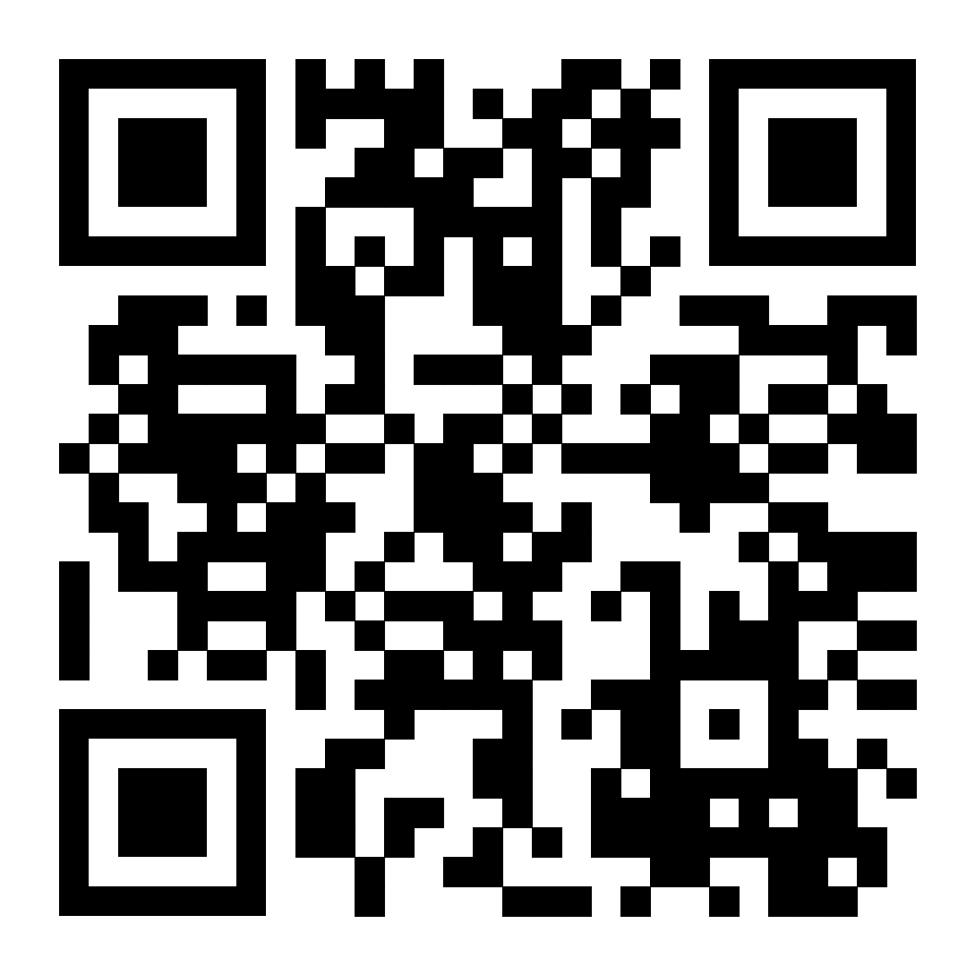
Course Descriptions
https://shorturl.at/kKO48

Slide 19
Information Night March 19th OHS Library Incoming Gr 10 & 11 6-6:45 pm Incoming Gr 12 7-7:45 pm

Slide 20
Questions?

Slide 21
Education is the passport to the future, for tomorrow belongs to those who prepare for it today.
“
”
Malcolm X

